Slide 1
NLP/IR Report week 2
Team IRun
20172864 서정현
20172848 정석우
20170364 한태균
Notes:
Hello, we are the Team ‘Irun’ and I’m presenter Seo Jeong Hyeon.
Let’s begin the presentation.

Slide 2
Index
Project summary
Progress
Preview
Notes:
I will divide my presentation into 3 parts.
First, I will talk about our project summary.
Next, I will discuss current progress.
Lastly, We’re going to look at preview

Slide 3

Project Summary
Notes:
Let’s start with project summary.

Slide 4
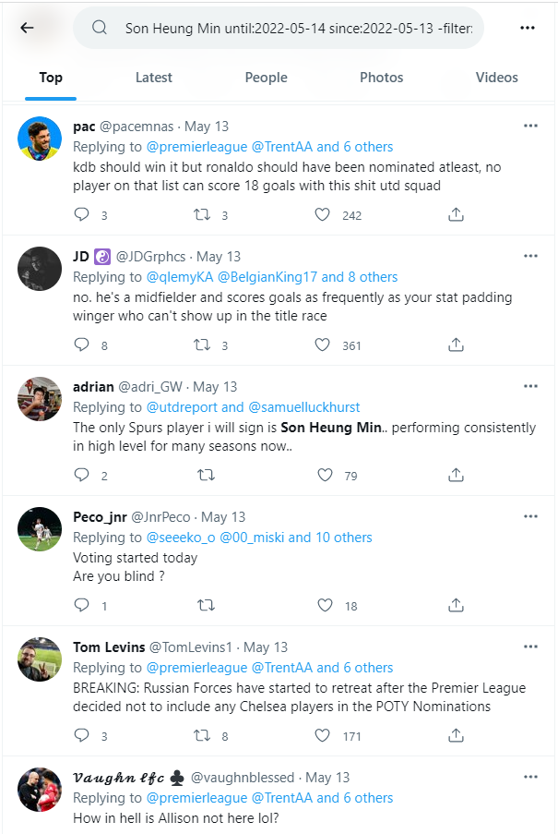
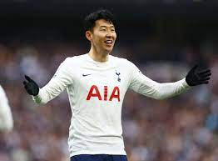
Summary
Query
User Rating: 8.5
Notes:
The goal of our project is to predict a player rating for a match through Twitter replies

Slide 5


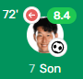
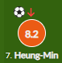
Summary
IRun Rating
Son 8.5
new indicator !
Notes:
Player ratings are given by various sites such as whoscored and fotmob.
We expect this ‘Irun rating’ could be a new football rating indicator given by non-professional users.

Slide 6
Plan
~1 weeks : Detailed Design, Set a goal
~2 weeks : Individual Crawling of Match, Rating, Tweets
~3 weeks : Sum up & Create docs, VSM
~4 weeks : Data processing, Evaluation modules
~5 weeks : End of development and modularization
~6 weeks : Bug fix
Notes:
This is our weekly plan.
This week we tried to crawl football matches, player ratings, and Twitter replies.

Slide 7

Progress
Notes:
Now, Let’s move on to progress.

Slide 8


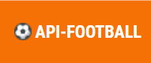
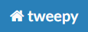

Web Search Idea
query
0~1
1~2
2~3
8~9
9~10
Notes:
Before the progress, This is our Web Search Idea.
We used two APIs to crawl data.
First, “api-football” provides a lot of information about football matches. We use this api to get a list of recent football matches, match dates, and player ratings for each match.
Second, “tweepy” helps crawling Twitter. We use information from the “api-football”, and collect all Twitter replies where the player was mentioned on the match day. These replies are added to the appropriate rating interval document.

Slide 9
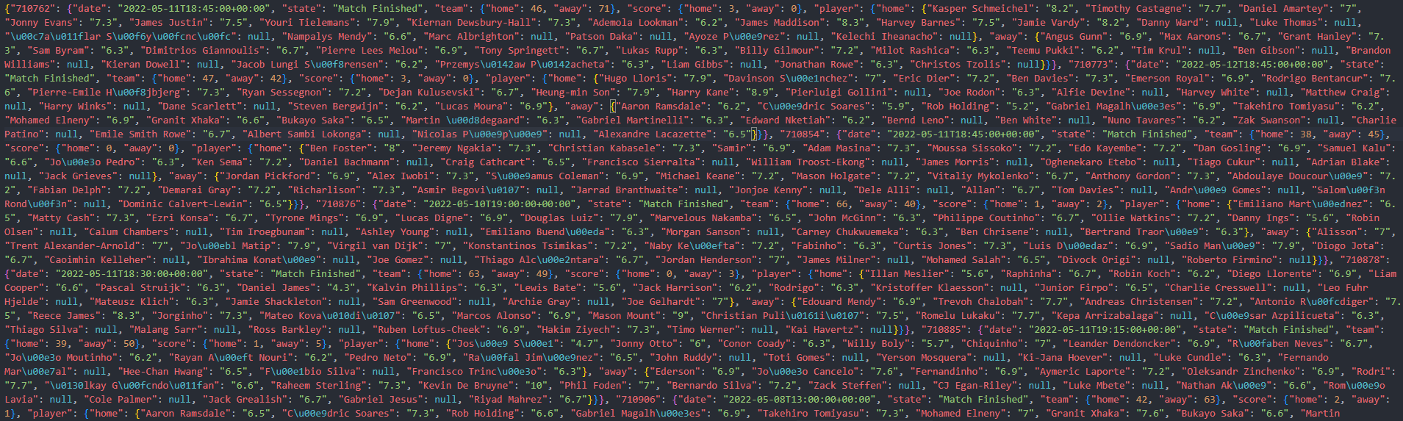
Match/Rating Crawling
Notes:
So, This is a collection of information about football matches using 'api-football’.
(zooming)
This is match id… This is match date… This is match state… but most important thing is here, the ratings for each players.

Slide 10
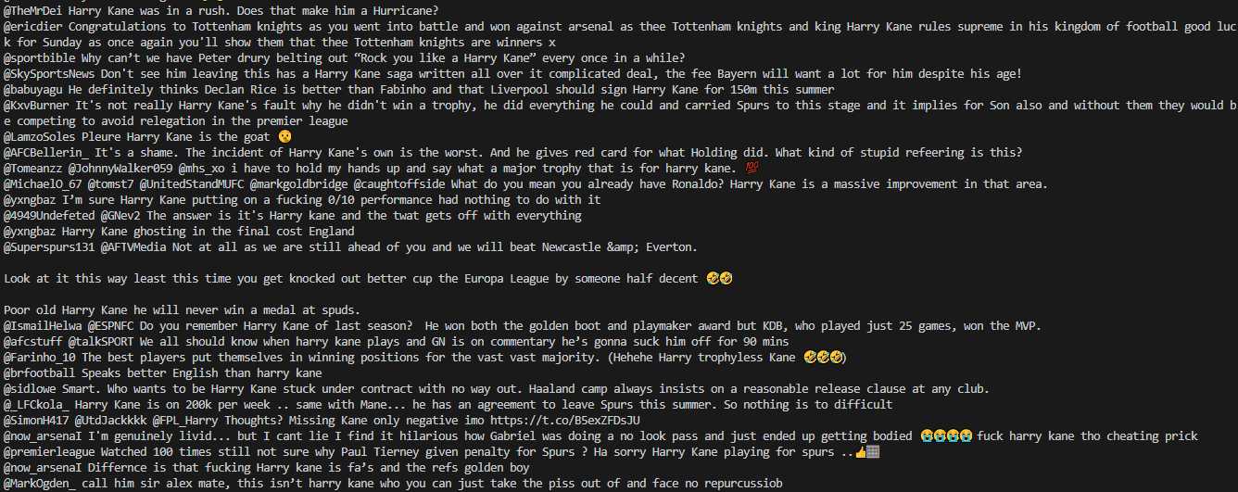
Tweets Crawling
Notes:
And, These are replies written after Harry Kane's match on the 13th, obtained via tweepy.

Slide 11

Preview
Notes:
Now, Let’s see a preview.

Slide 12
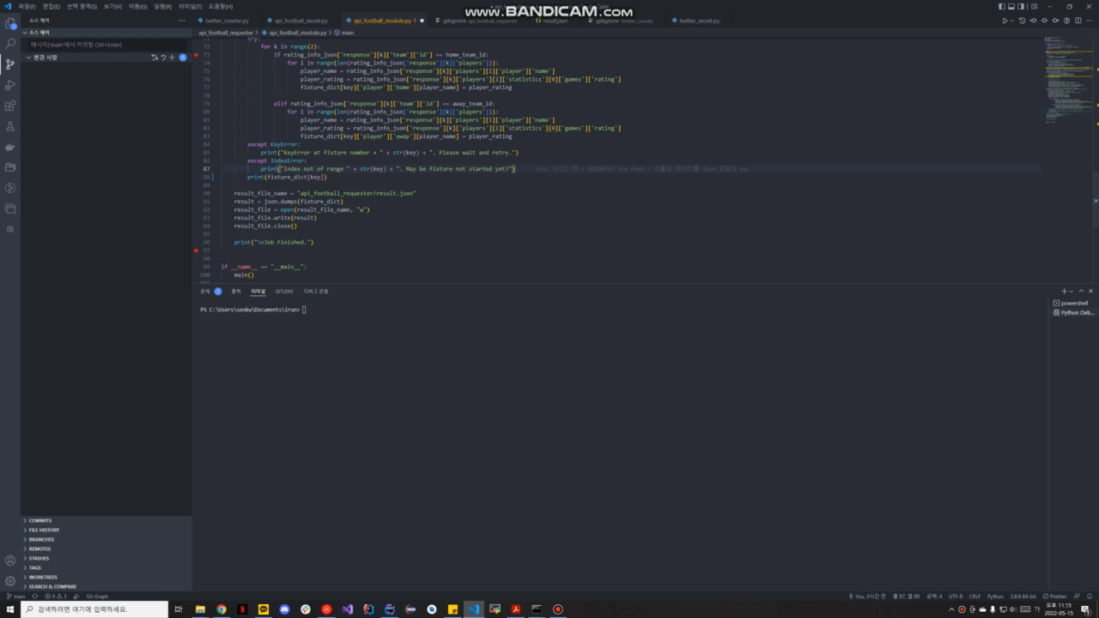
Notes:
In this video, we are crawling information about Premier League matches for a week

Slide 13
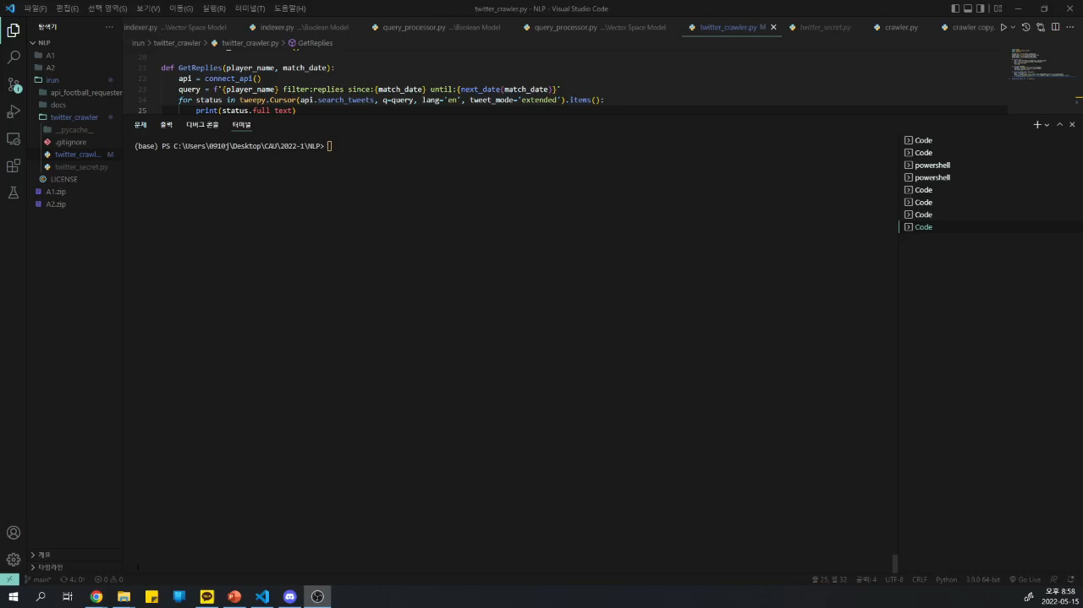
Notes:
In this video, we are crawling Twitter replies to Harry Kane on 13 May during the match between Tottenham and Arsenal.

Slide 14
reference
https://github.com/tweepy/tweepy
https://www.api-football.com/
Notes:
These are references.

Slide 15
Thank you
Notes:
Thank you for your attention

